Slide 1
Features Engineering

Slide 2
Feature Engineering
Feature Transformation
Feature construction-
Feature subset selection
Feature Subset Selection

Slide 3
Feature construction-
Process of discovers missing information about the relationships between features and augment the feature space by creating additional features
If n features in dataset ,after feature construction m more features added.
Now data set with m+n features.

Slide 4
Feature Construction-Encoding categorical(Nominal ) variables
Example:
The city where a person lives: Delhi, Mumbai, Ahmedabad, Bangalore, etc.
The department a person works in: Finance, Human resources, IT, Production.

Slide 5
One Hot Encoding
We use this categorical data encoding technique when the features are nominal(do not have any order).
In one hot encoding, for each level of a categorical feature, we create a new variable. Each category is mapped with a binary variable containing either 0 or 1. Here, 0 represents the absence, and 1 represents the presence of that category.

Slide 6
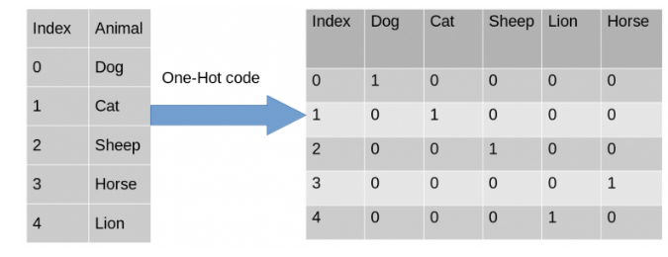

Slide 7
Feature Construction-Encoding categorical(Ordinal ) variables
In Label encoding, each label is converted into an integer value.
Marks | Grade
90 | A+
87 | A
66 | B
54 | C

Slide 8
Ordinal data: This type of categorical data consists of a set of orders or scales. For example, a list of patients consists of the level of sugar present in the body of a person which can be divided into high, low and medium classes.

Slide 9
Label Encoding or Ordinal Encoding
Marks | Grade
90 | 1
87 | 2
66 | 3
54 | 4

Slide 10
Transforming numeric features into categorical features
Text Specific feature construction

